Slide 1
Segmenting The Business Market
Dr. AMA Suyanto

Slide 2
Knowing the Customer is Not Enough!
Once we know the customer, we need to understand what new products, services and features will excite them.
Our job is to know the customer so well that we can provide him or her with (technological) solutions to problems that they don’t even know exist yet!

Slide 3
High-growth companies, large and small, succeed by
Selecting a well-defined group of potentially profitable customers
Developing distinctive value propositions that competitively meet customer needs
Focusing marketing resources on acquiring, developing, and retaining profitable customers

Slide 4
Market
“People or organizations with needs or wants, the ability to purchase and the willingness to buy.”
Requirements Evaluating Potential Market Segment
Compatibility
Measurability
Accessibility
Substantiality
Responsiveness
Degree to which the firm’s marketing and business strengths match the present and expected competitive and technological state of the market
Market Segment
“A group of present or potential customers with some common characteristic which is relevant in explaining (and predicting) their response to a supplier’s marketing stimuli”
degree to which the segments are large or profitable enough to be worth considering for separate market cultivation.
degree to which segments respond differently to different marketing mix elements such as pricing or product features.
Market Segmentation
“The process of dividing a market into meaningful, relatively similar and identifiable segments or groups.”
degree to which the firm can effectively focus its marketing efforts on chosen segments.
degree to which information on particular buyer characteristics exists or can be obtained.

Slide 5
Better matching of customer needs
Enhanced opportunity for growth
Retention of Customer
Targeted IM Communications
Share of the Market Segment
Enhanced operational eficiency
Better share of Cutomer Wallet
Why Segmentation?

Slide 6
Segmentation Benefits
Attunes marketer to unique needs of customer segments
Focuses product development efforts, develops profitable pricing strategies, selects appropriate distribution channels
Provides valuable guidelines to allocate marketing resources.

Slide 7
Business Marketing Segmentation
Business Market
Macro Segmentation
Geographic
Customer Type
Micro Segmentation
Purchasing Criteria
Customer Size
Product Use
Purchasing Strategy
Importance of Purchase
Personal Characteristics

Slide 8
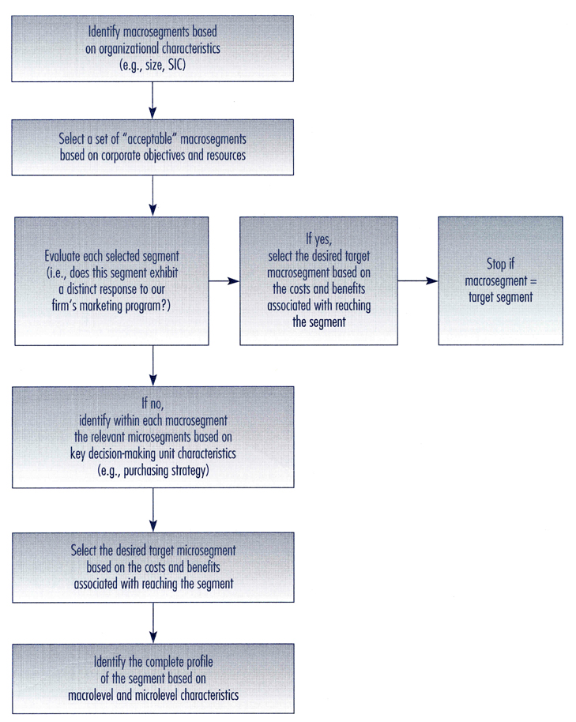
An Approach to Segmentation of Business Markets

Slide 9
Choosing Market Segments
As you can see, there are numerous steps to choosing market segments.
We start by analyzing key characteristics of the organization and of the buying situation (macro-dimensions) to identify, evaluate and select a meaningful macro-segment.

Slide 10
Segmentation Model
Identify key characteristics (macro-segments) based on organizational characteristics (e.g.: size, NAICS)
Consider the buying situation in terms of macro-dimensions (i.e., Where are they in the procurement cycle – new task, rebuy, modified rebuy?)
Select set of acceptable macro-segments based on corporate objectives and resources.
4 Evaluate each segment that possesses distinct needs, is open to a distinct message and is responsive to your marketing program.
5. If Step 4 is successful, select macro-segment as the target market and complete a cost/benefit analysis for marketing to it.

Slide 11
Implementing a Segmentation Plan
A well-developed segmentation plan will fail unless the following issues are addressed:
How should the sales force be organized?
What services will the new segment require?
Who will provide the new services?
How do we contact the new segment?
Can we support the new operation?
Will new adaptations be necessary to serve the international market?

Slide 12
Segmentation Summary
Managing the implementation of segmentation is a difficult task at best. It means the product/service mix needs to be customized for diverse segments.
It demands inter-organizational coordination and cooperation.
Managing critical points of customer contact is one of a marketing manager’s fundamental roles.

