Slide 1
CHAPTER 5
SUPPLY CHAIN MANAGEMENT
Dr. AMA Suyanto

Slide 2
Formal Definition:
“The integration of business processes from end user through original suppliers that provide products, services, and information that add value for customers.”

Slide 3
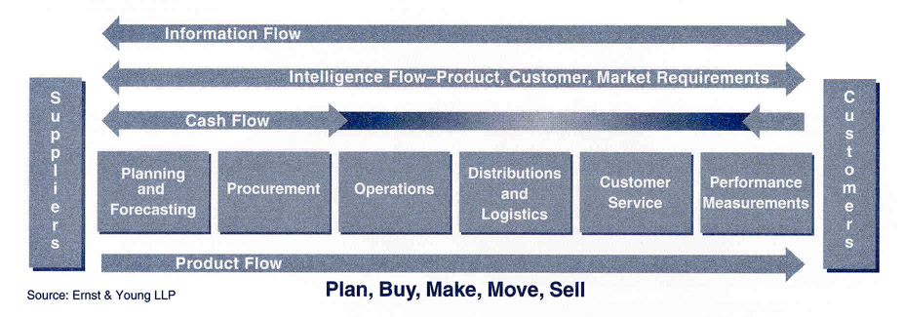
The Supply Chain Model
Note the key elements of supply chain management and the important integration that must take place among a variety of business functions across different organizations in the supply chain.

Slide 4
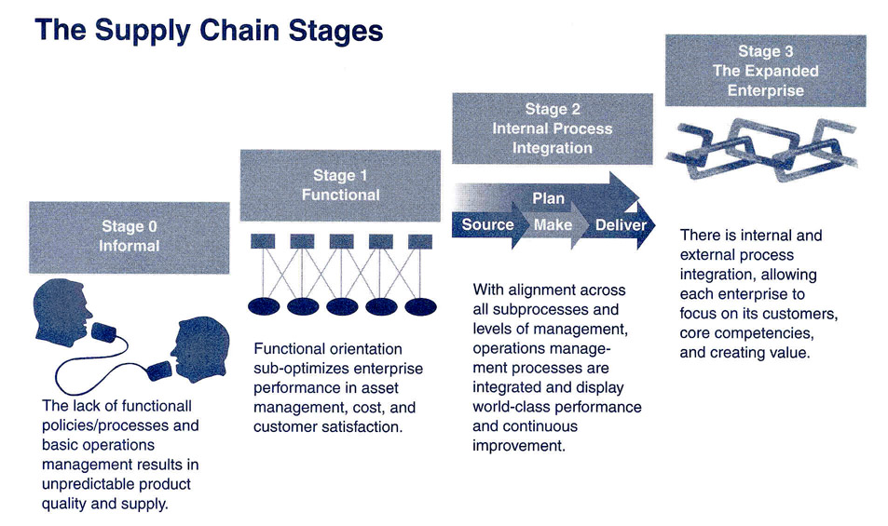
Effective supply chains conduct business as partners and openly share information across the supply chain.
Stages Firms Go Through in Adopting Supply Chain Management

Slide 5
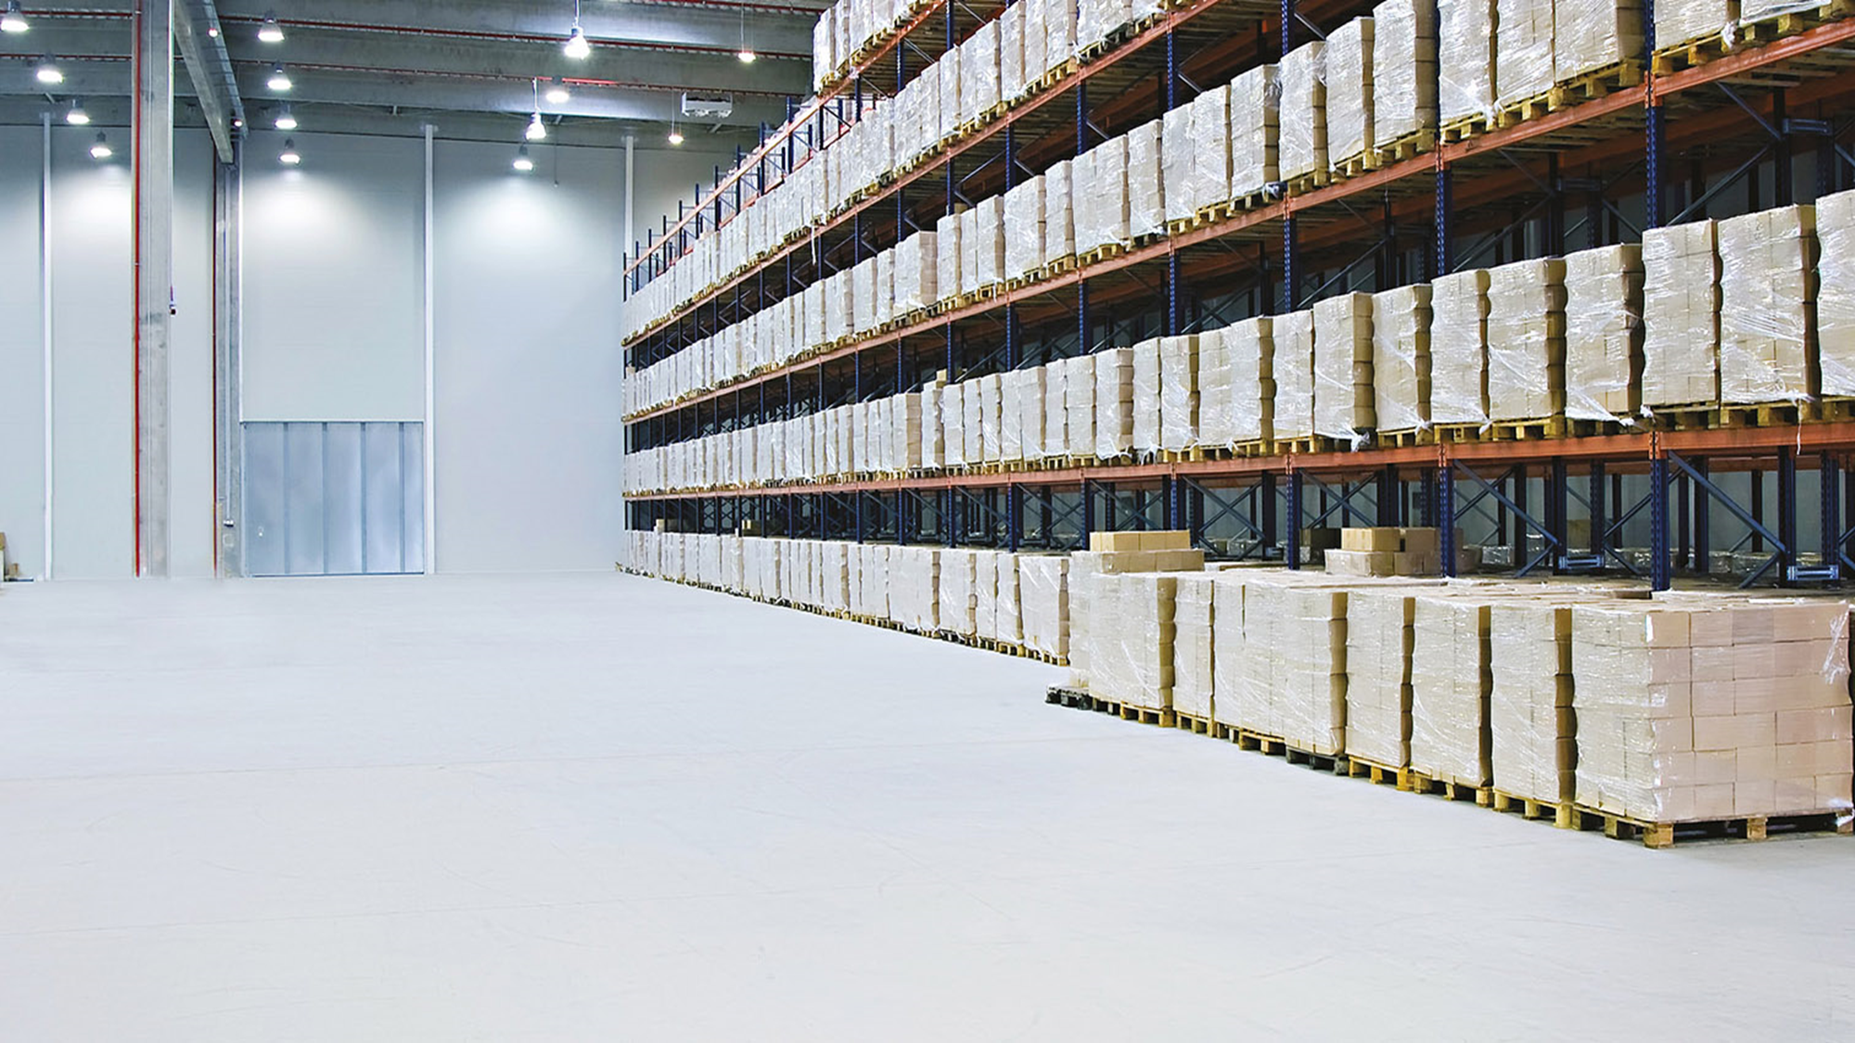
SCM Goals
minimize duplication, harmonizing operations and systems and enhancing quality.
compression of order to delivery cycle time.
Waste Reduction
Time Compression
Unit Cost Reduction
Flexible Response
the meeting of customer’s unique requirements in a cost effective manner.
reduce cost per unit to the end user by first determining the level of performance desired by the customer.

Slide 6
The Strategic Role of Logistics
Sales-Marketing-Logistics Integration
Just In Time System

Slide 7
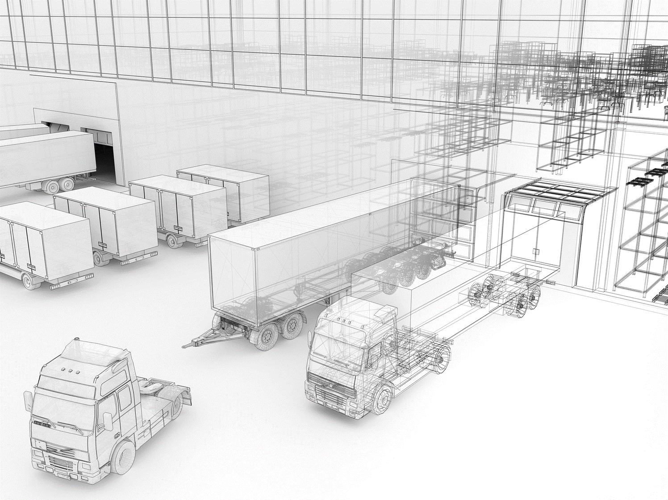
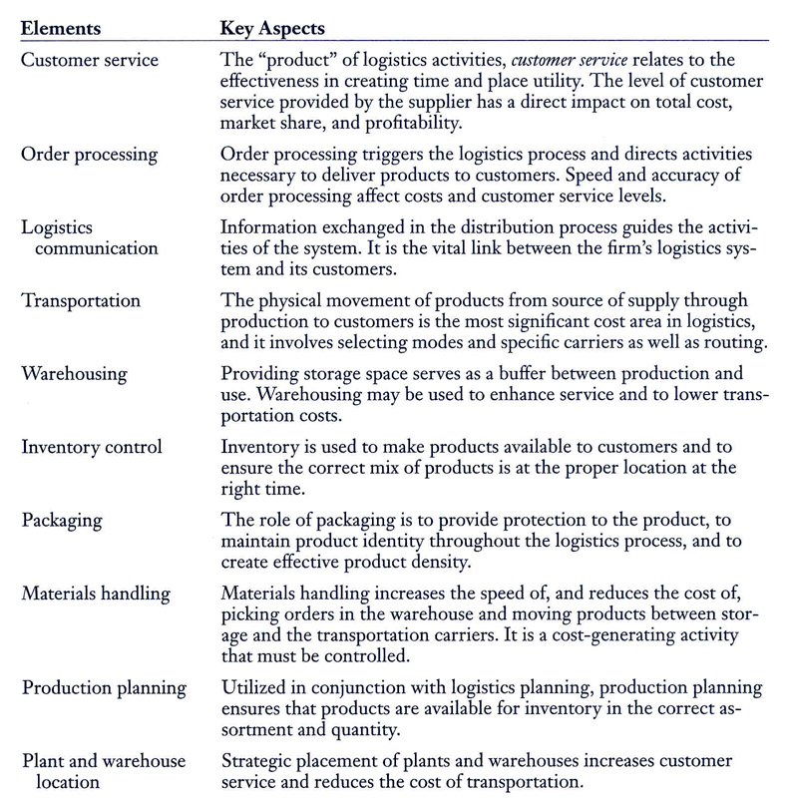
CONTROLLABLE ELEMENTS IN A LOGISTICS SYSTEM
Virtually no logistical decisions can be made without evaluating how it might effect other logistical areas.
Source: Adapted from James R. Stack and Douglas M. Lambert, Strategic Logistics Management, 5th ed. (Homewood, Ill.: McGraw-Hill, 2000)

Slide 8
Total Cost Approach Variables
Total Distribution Costs
The Level of Logistical Services Provided to Customer

Slide 9
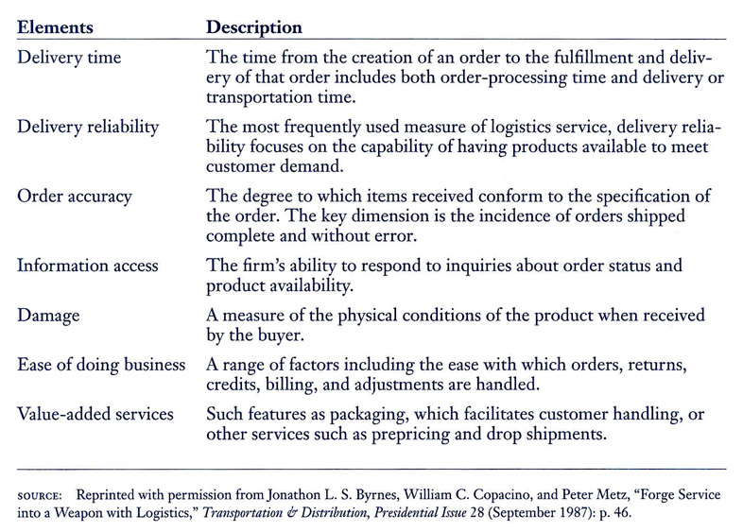
Logistical service relates to the availability and delivery of products to the customer.
Responsive logistical service advances customer satisfaction and develops the seller-buyer relationship.
Common Elements of Logistics Service

Slide 10
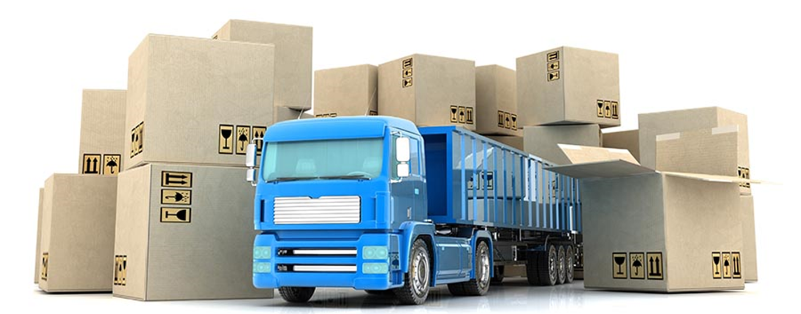
B2B Logistical Management Considerations
Logistical Facilities.
Transportation.
Inventory.
Third Party Logistics
Serving Other Supply Chain Members
Outsourcing the Warehousing Function
Transportation & Logistical Service
Transportasi Performance Criteria (cost of service, speed of service)
Quality Focus
The 80/20 rule (80 sales, 20 production)

Slide 11
Importance of Inventory Management
Production and demand are not perfectly matched.
Operating deficiencies in the logistical system often result in product unavailability.
Business customers can not predict their product needs with certainty.

