Slide 1
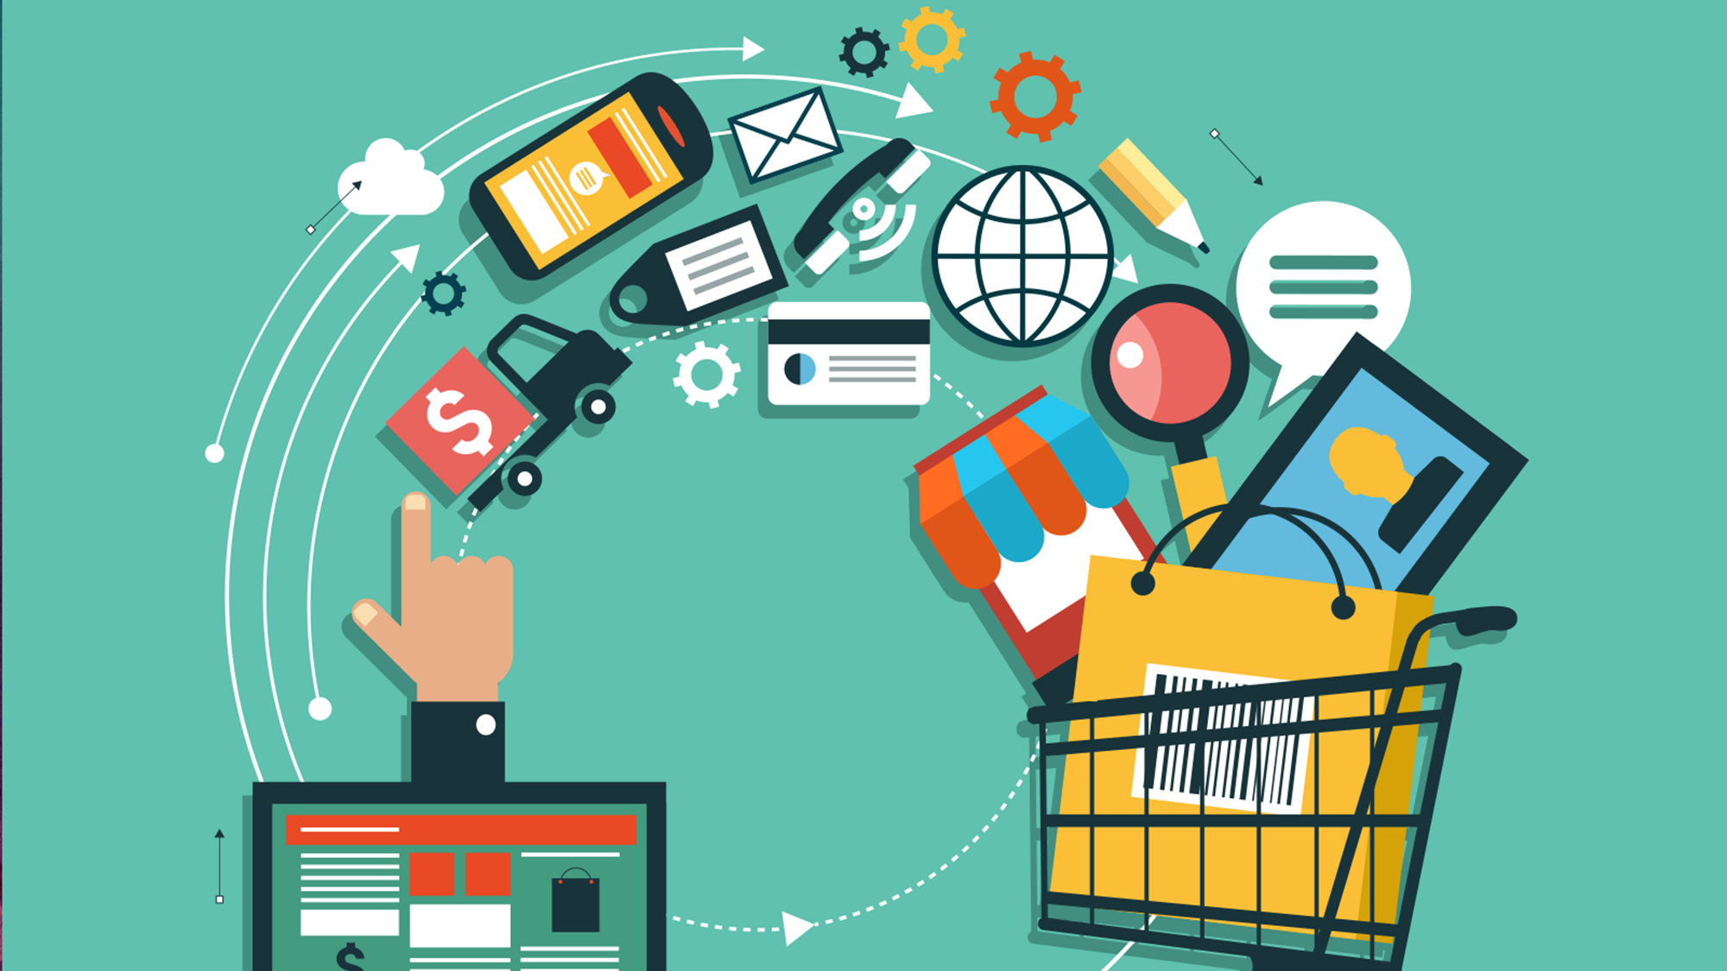
E-Commerce Strategies for Business Market
Dr. AMA Suyanto

Slide 2
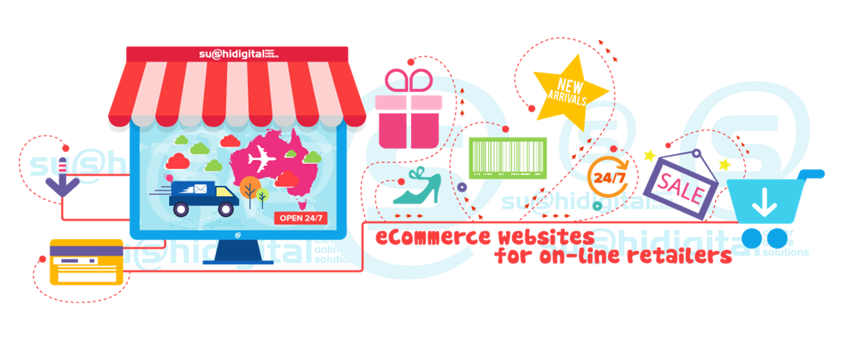
The buying and selling of products and services by businesses and consumers through an electronic medium, without using any paper documents.
E-commerce is widely considered the buying and selling of products over the internet, but any transaction that is completed solely through electronic measures can be considered e-commerce.

Slide 3
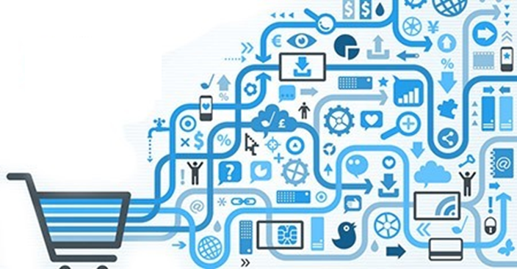
E-Commerce can be viewed from several perspectives
E-commerce is the delivery of information, product or services, or payments via telephone lines, computer networks, or any other electronic means
E-commerce is a tool that addresses the desire of firms, customers and management to cut service costs while improving the quality of goods and increasing the speed of service delivery
Communications standpoint
Business Process Perspective
Service Perspective
Online Standpoint
E-commerce is the application of technology toward the automation of business transactions and work flows
E-commerce provides a vehicle for the buying and selling of production and information on the internet and for other online service

Slide 4
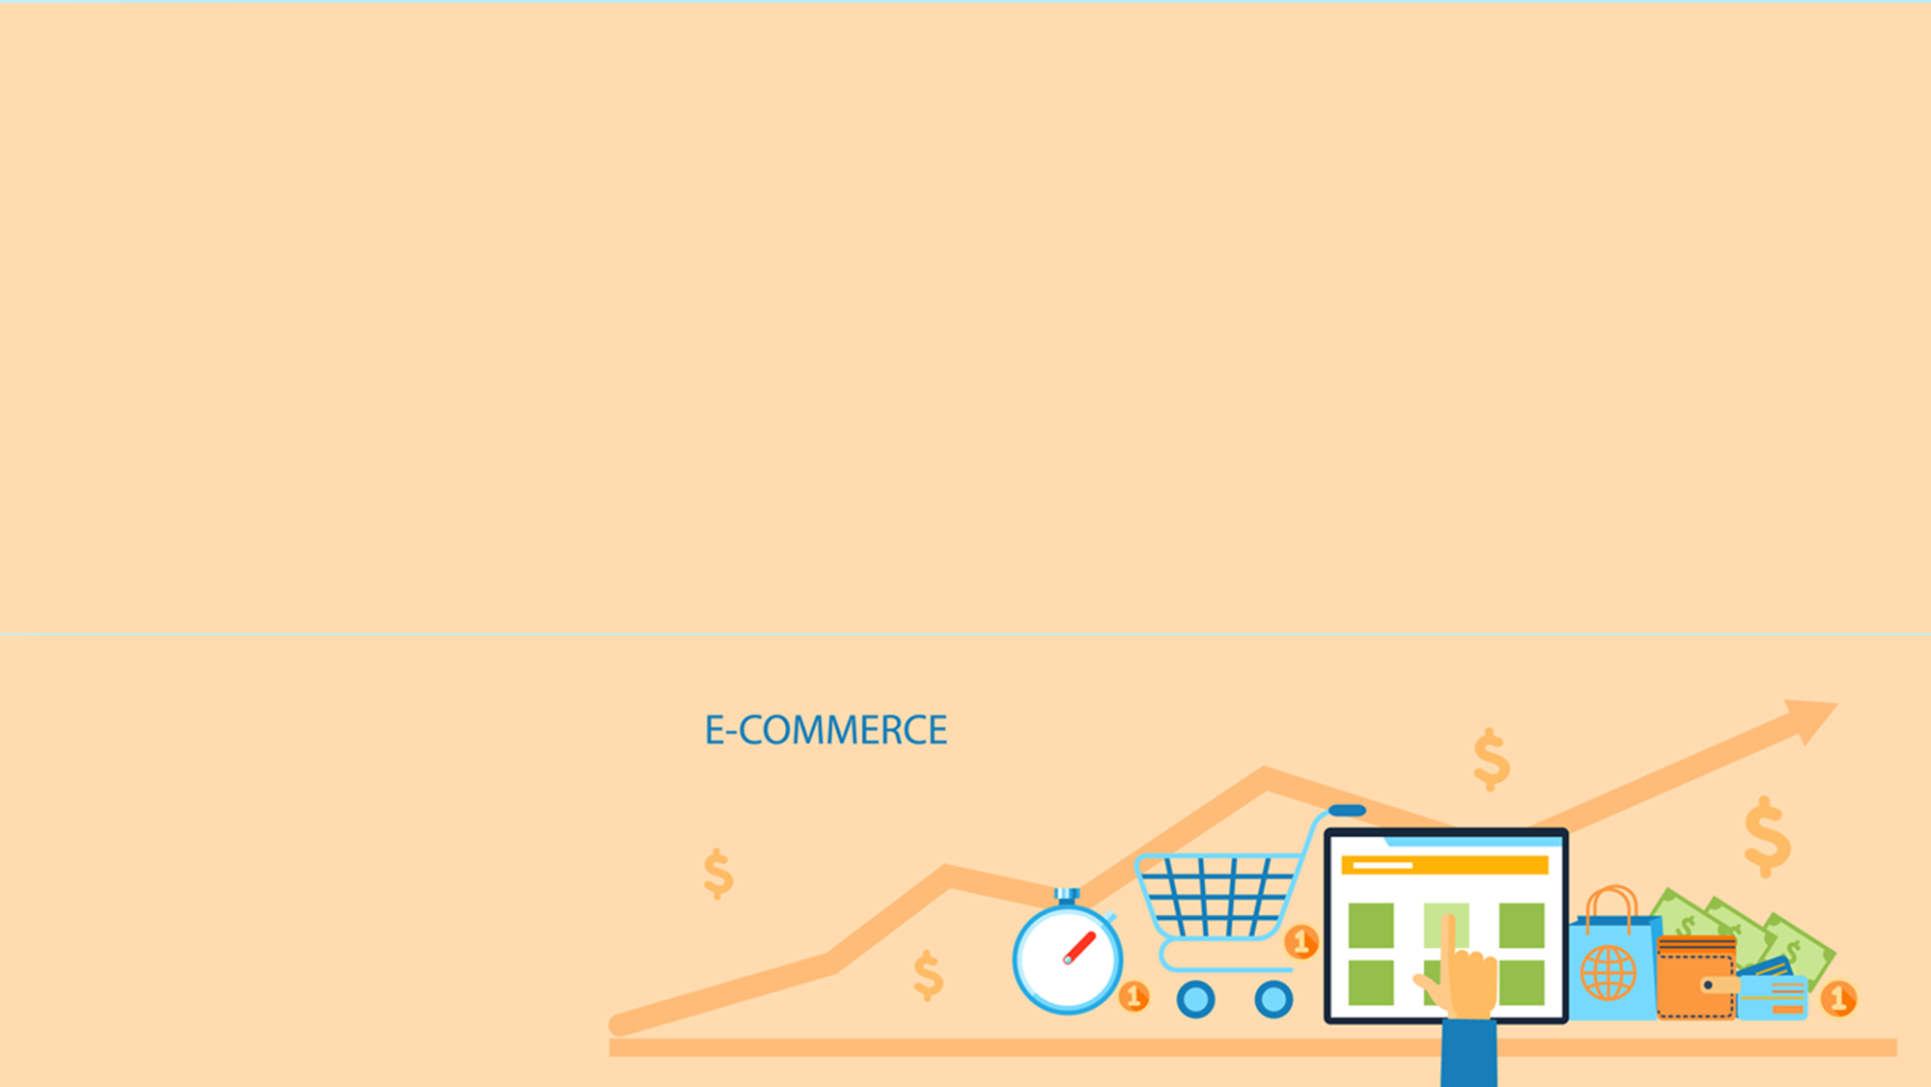
The Internet and World Wide Web
Intranets and Extranets
Key elements Supporting
e-Commerce

Slide 5
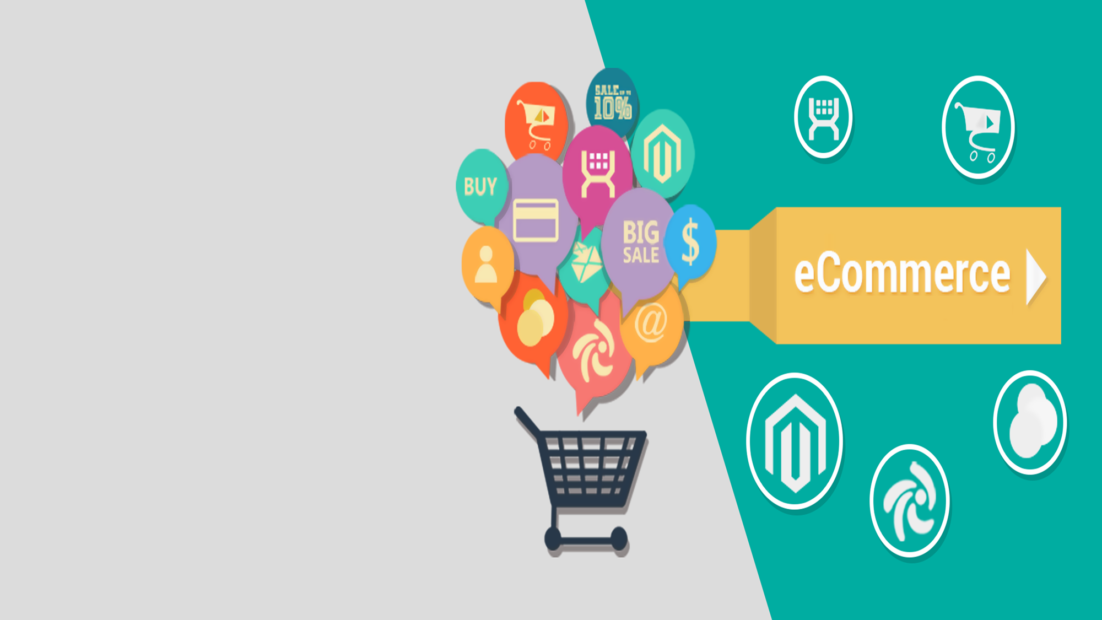
Supplier management
Inventory Management
Distribution Management
Channel Management
Payment Management
Interorganizational e-Commerce
Intraorganizational e-Commerce
Business to Customer e-Commerce
Types of
Product Information
Sales
Service
Payment
Marketing Research
Workgroup Communication
Electronic Publishing
Sales Force Productivity

Slide 6
What can it do?
Internet can cause some companies to fail
Internet should complement existing technology
What else can it do?
The Strategic Role of E-commerce
Enhance customer focus, responsiveness, and relationships
Reduces transaction costs
Integration into supply chain
Focus on core business
Access global markets
Communication device with customers
Alternative distribution channel
Valuable medium for delivering services
Tool for gathering marketing research data
Method for supply chain integration

Slide 7
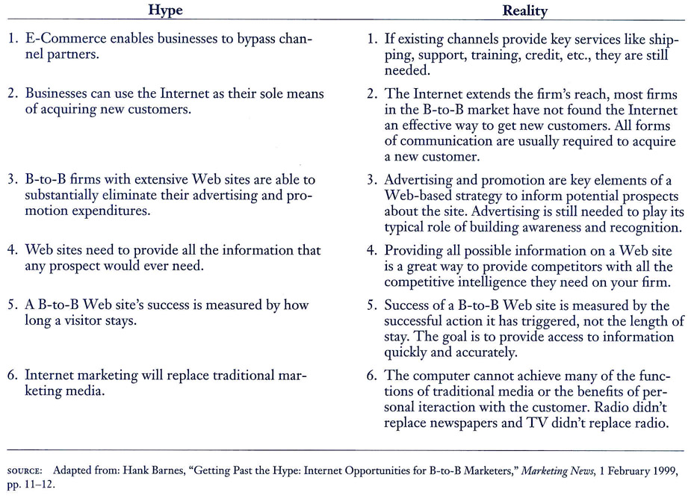
The “Hype” and Reality of

Slide 8
What Is The Internet
A communications device.
An alternative distribution channel.
A means to deliver services.
A tool for gathering marketing research data.
A method for integrating the supply chain.
Internet Advantages
Effectively serve customers.
Ability to communicate information.
Lowering the cost of doing business.
Reduced Transaction Costs
Integration of the Supply Chain
Focus on Core Business
Effective Information Availability
Access Global Markets

Slide 9
Customers and Markets
Competitive Threats
People and Infrasrtucture
Source and Operations
Spesific Objectives of Internet marketing Strategies
Target a specific market
Build recognition of company name
Convey a cutting edge image
Conduct market research
Interact with existing customers
Real-time information about customers, products, etc.
Sell products and services
Sell more efficiently
Advertise in a new medium
Generate leads
Provide customer service medium
Build strong relationships
Crafting an E-commerce Strategy

Slide 10
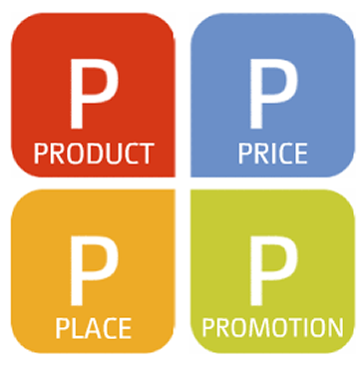
Website
Successful design
Internet catalogs
Reverse auctions
Impact of new markets
Real-time advantages
Levels
Online information
Database publishing
Customer self-service
Transactions
Meet Customer Requirements
Complements personal selling
Role of sales force
Other promotions
Internet Strategy Implementation

Slide 11
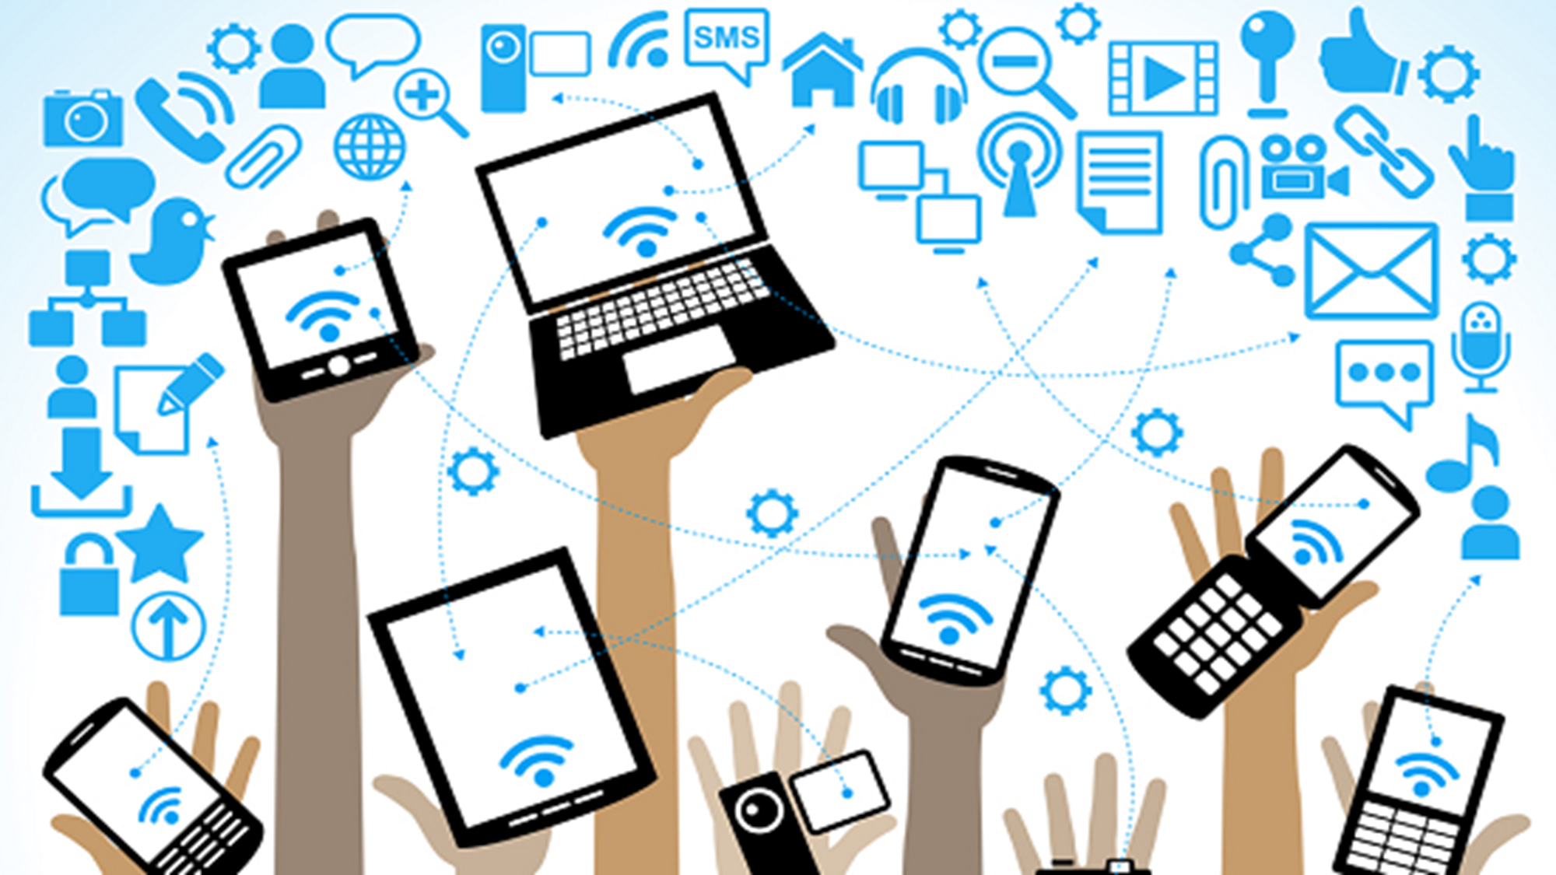
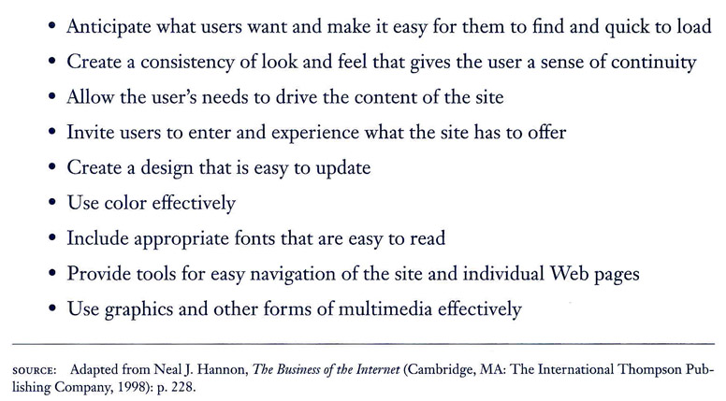
Guidelines for Developing an Effective Web Site

Slide 12
Digital Channel Advantages
Can be customized to the buyer’s need.
Provides a wide range of referral sources.
The internet is always open for business.

